Slide 1
Analyzing Voting Patterns Based on Race in U.S. Counties
A Statistical Approach to Understanding Electoral Behavior
Created by Jude Younis

Slide 2
Introduction
Objective
Data Sources
Analyze how the majority race in a random U.S. county might influences voting patterns, particularly the likelihood of voting Republican or Democrat.
Primary dataset from the 2020 U.S. elections and supplemental demographic data from the U.S. Census (all sourced from Kaggle, will share actual link last slide).

Slide 3
Data and Methodology
Data Overview:
Election Data: County-level voting results.
Census Data: Demographic information, including majority race.
Methodology:
Proportion Test (Z-Test): To assess the likelihood of White-majority counties voting Republican.
Chi-Square Test: To analyze the association between race and voting patterns.
T-Test: To compare voting patterns between White-majority and Non-White-majority counties.

Slide 4
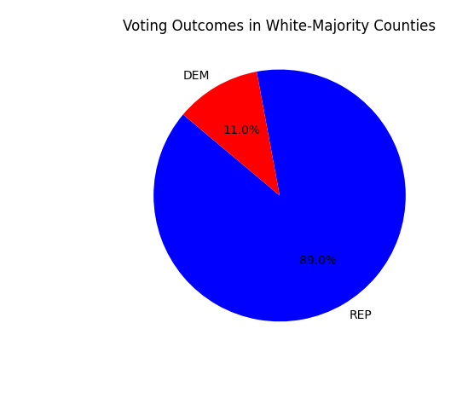
Results - Proportion Test
Key Findings
Statistical Insights
White-majority counties have a significantly higher likelihood of voting Republican.
Z-Statistic (65.739) and P-value (0.0)

Slide 5
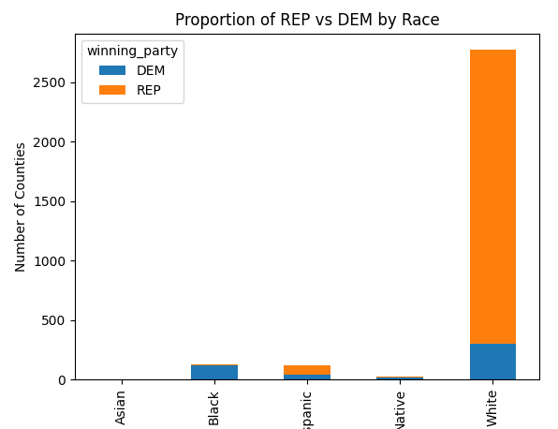
Results - Chi-Square Test
Key Findings
Statistical Insights
There is a strong association between race and voting patterns.
Chi-Square Statistic (690.51) and P-value (3.96e-148)

Slide 6
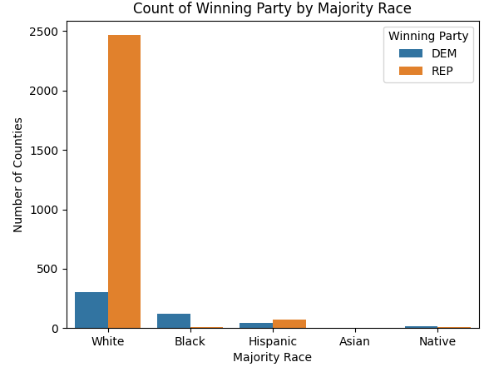
Results – T Test
Key Findings
Statistical Insights
Significant difference in voting patterns between White-majority and Non-White-majority counties.
T-Statistic (18.561) and P-value (1.62e-51)

Slide 7
Tree Diagram
Will Vote 91% Democrat 9% Republican
County Majority Race
Black
Not Black
Will Vote 37% Democrat 62% Republican
Will Vote ~1% Democrat
99% Republican
Will Vote 56% Democrat
44% Republican
Will Vote 11% Democrat
89% Republican
Native
Hispanic
White
Asian

Slide 8
Insights
Asians are more prone to vote for Rep, but as they make up a minority of the USA population, I did not focus on
Hispanics make up 18% of the population, we clearly see Hispanic majority counties prefer to vote Republican
Whites make up most of the USA, making about 60% of the population, so we will mostly focus on how they affect Election Results.

Slide 9
Conclusion
Race as a Determinant: Race is a significant factor in predicting whether a county will vote Republican or Democrat.
White, Asian & Hispanic Majority Counties: Strongly favor Republican candidates.
Importance of Demographics: Demographic factors are crucial for understanding electoral behavior.

Slide 10
Thank You!
If I fail the course, next year maybe well do an analysis on how the changes in the demographic of the USA has changed Election results over the decades

Slide 11
Data Sources
https://www.kaggle.com/datasets/unanimad/us-election-2020
https://www.kaggle.com/datasets/muonneutrino/us-census-demographic-data

